Slide 1
Predictive Maintenance (PdM) in Cement Industry:
VCW Approach & Case Studies Examples
Christina Keravnou, PhD
Mechanical Maintenance Manager
November 2025

Slide 2
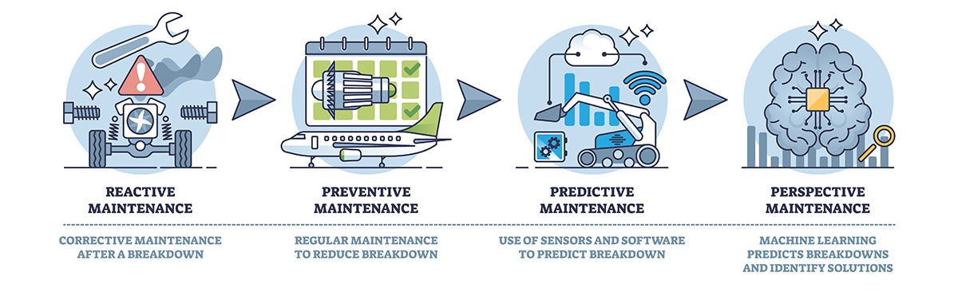
Evolution of Maintenance
Notes:
Condition Based Maintenance (CMB) is a maintenance plan that uses Condition monitoring tasks/techniques to determine if corrective actions are required on machinery parts.
Condition monitoring tasks/techniques are performed on a frequent or real-time basis and compare machinery operation state to an established baseline operation condition.

Slide 3
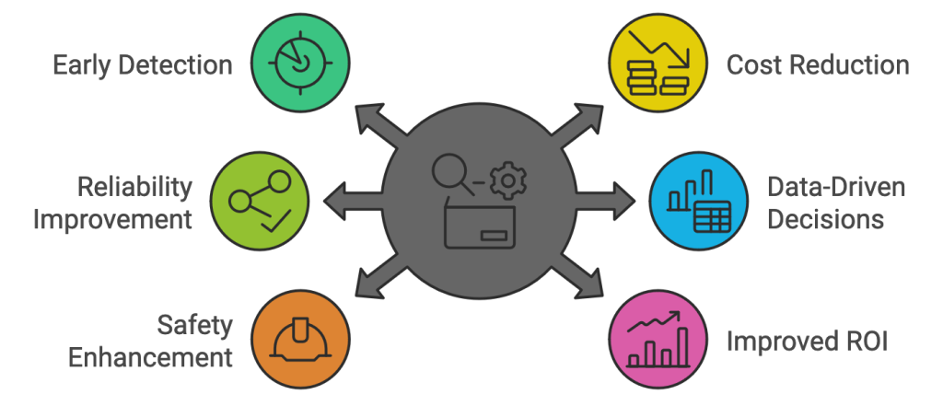
Why Condition Monitoring?
Notes:
Reduced Unplanned Downtime CBM enables early detection of potential failures by continuously monitoring equipment conditions, allowing for timely interventions and minimizing unexpected breakdowns.
Lower Maintenance Costs By performing maintenance based on actual equipment needs rather than fixed schedules, CBM reduces unnecessary labor and parts replacement, leading to cost savings.
Extended Equipment Lifespan Timely maintenance helps prevent severe damage, thereby prolonging the operational life of machinery and reducing the frequency of replacements.
Enhanced Operational Efficiency CBM allows for better planning and resource allocation, ensuring that maintenance activities are performed when necessary, thereby improving overall productivity.
Improved Safety Regular monitoring and timely maintenance reduce the risk of equipment-related accidents, contributing to a safer working environment.
Optimized Resource Allocation By focusing maintenance efforts on equipment that requires attention, CBM ensures that resources are used effectively and efficiently.
Data-Driven Decision Making CBM provides valuable insights through data analysis, enabling informed decisions regarding maintenance strategies and asset management.

Slide 4
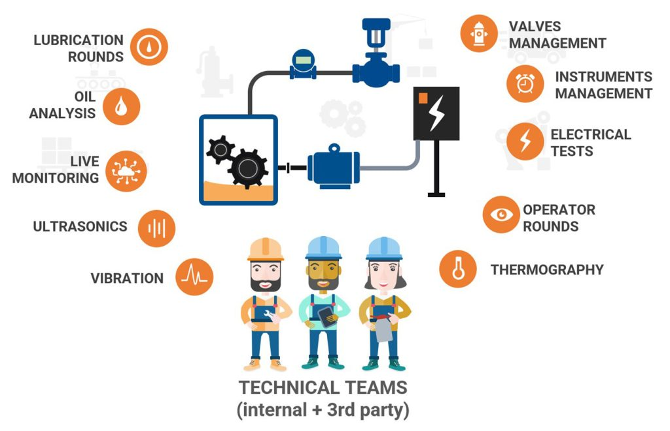
Condition-Based Monitoring Techniques

Slide 5
Condition-Based Monitoring Techniques
Vibration analysis
Thermography
Lubricant analysis
Acoustic measurements
NDT
Electrical measurements
Monitors vibration trends to assess early mechanical issues.
Imbalance, misalignment, looseness, bearing wear and other issues are identified before they cause equipment failure.
Uses infrared imaging to detect temperature variations.
Examines lubricant samples to evaluate equipment condition.
Leakages, bearing and gear damages.
Monitors sound patterns to detect equipment issues
Electrical problems, mechanical friction, and process inefficiencies are identified.
Bearing issues and gas, liquid or vacuum leaks are detected.
Analyzes current, voltage, and other electrical parameters to evaluate equipment condition.
Monitors material degradation, identifies internal flaws, and evaluates structural integrity
Ultrasonic Testing (UT), Radiographic Testing (RT), Magnetic Particle Inspection, Dye Penetrant Testing.

Slide 6
Sources of Vibrations
unbalance, eccentricity
alignment faults
play, backlash
gear meshing
gear defects
antifriction bearing defects
lubrication
driving machine
process induced
…

Slide 7
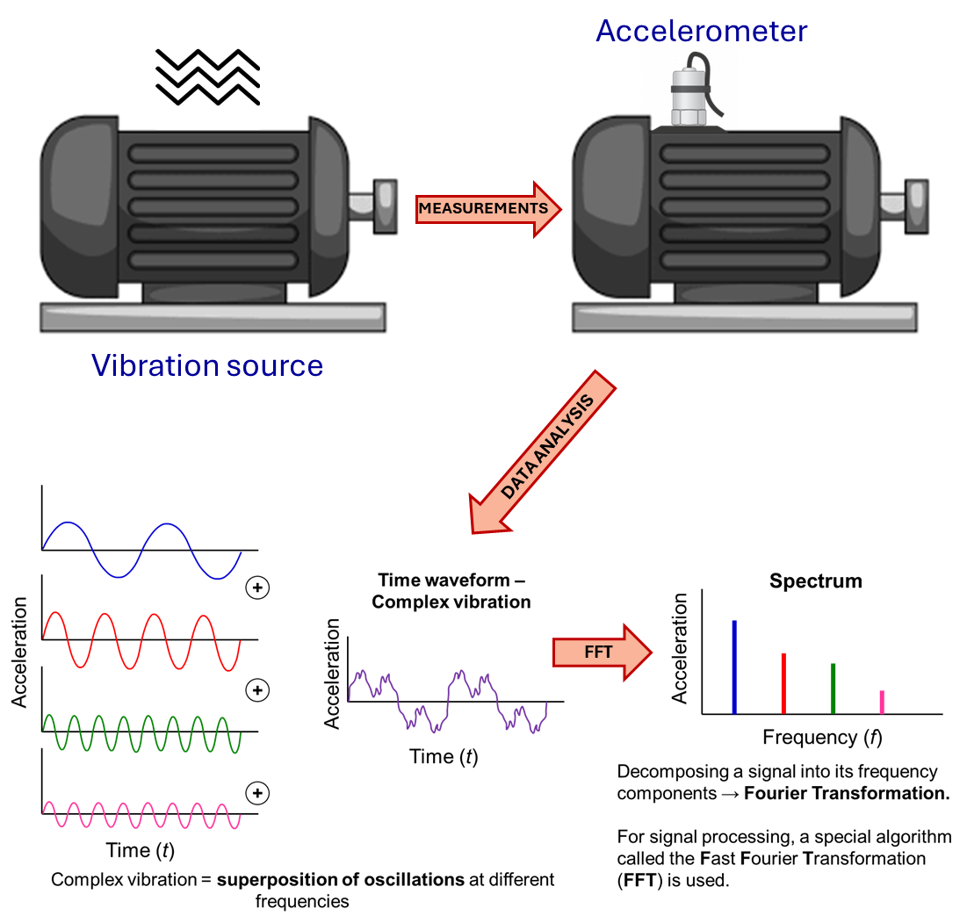

Vibration Measurements
Objective: Detect abnormal vibration behavior in rotating machinery
Measurement Tools:
Accelerometers / velocity sensors
Proximity probes
Portable data collectors / FFT analyzers
Typical Measurement Points:
Bearings, shafts, motor housings, gearboxes, pumps and foundations
Best Practices:
Collect data under normal operating conditions and in certain periodicity
Take readings in horizontal, vertical, and axial directions (x,y,z)
Compare against baseline or previous measurements
Key Parameters:
Amplitude: Displacement, velocity, or acceleration
Frequency (Hz): Determines fault type
Phase: Useful for balancing and alignment

Slide 8
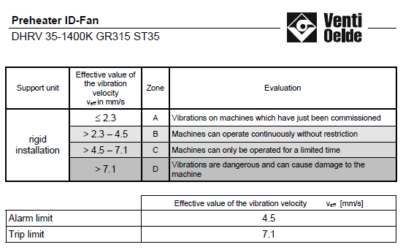
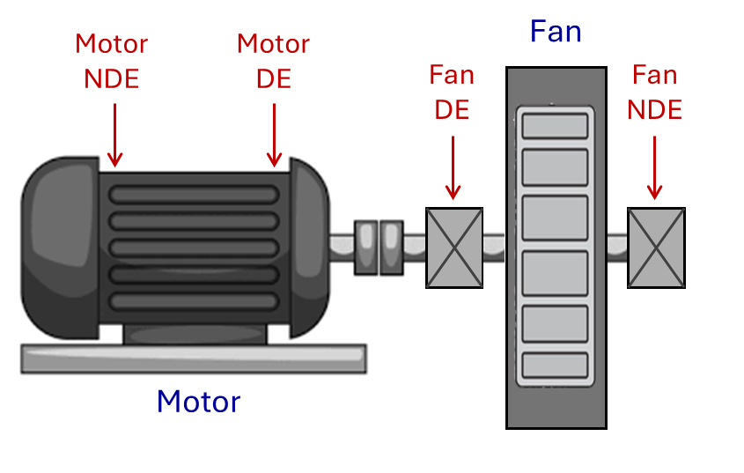
Case Study I
Asset ID: H50-155FN
Asset Description:
Preheater ID-Fan (ΟΕΜ: Venti Oelde)
Impeller ø 3120 mm
Impeller weight 3931 Kg
Criticality in Production: High (Operation time: continuous)
Measuring equipment:
Leonova Diamond SPM
Triaxial Accelerometer, SPM
Measurement Points:
Motor NDE, Motor DE
Fan DE Bearing, Fan NDE bearing
Measurement Periodicity: Monthly
Speed: 800 – 900 RPM
Notes:
Criticality in Production: High
Maintains Negative Pressure: Ensures smooth gas flow through the kiln, preheater, and dust collection systems.
Controls Combustion & Draft: Regulates airflow for stable kiln operation and efficient fuel burning.
Enhances Heat Transfer: Promotes effective heat exchange between hot gases and raw materials, improving energy efficiency.
Supports Emission Control: Draws gases through ESPs or bag filters to reduce dust and pollutant emissions.
Protects Equipment & Clinker Quality: Maintains proper pressure and temperature, ensuring safe operation and consistent clinker formation.

Slide 9
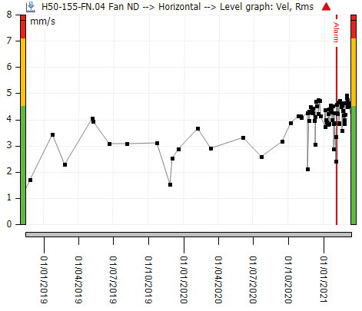
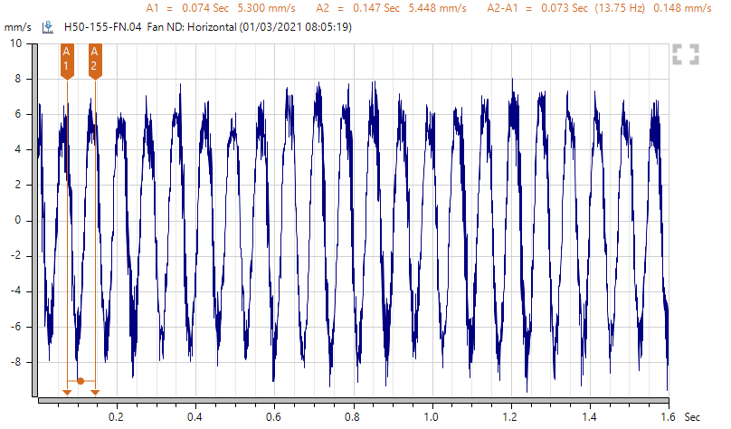
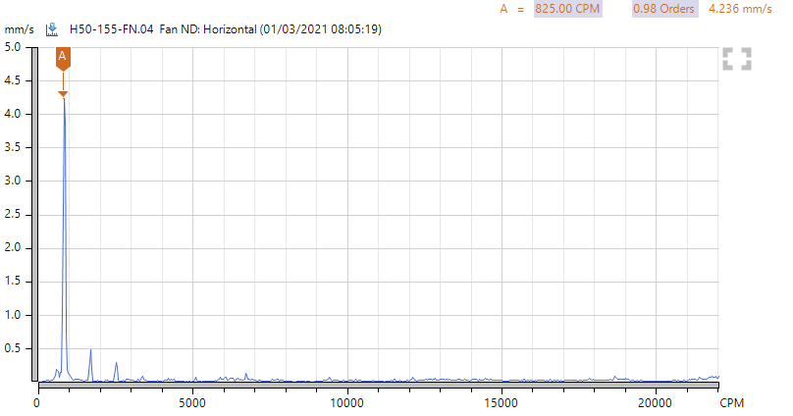
Case Study I
1x RPM
825
FFT
Observations:
Fan NDE vibration (Vrms) increased at horizontal direction
Energy is concentrated at 1x RPM peak – indicating unbalance

Slide 10
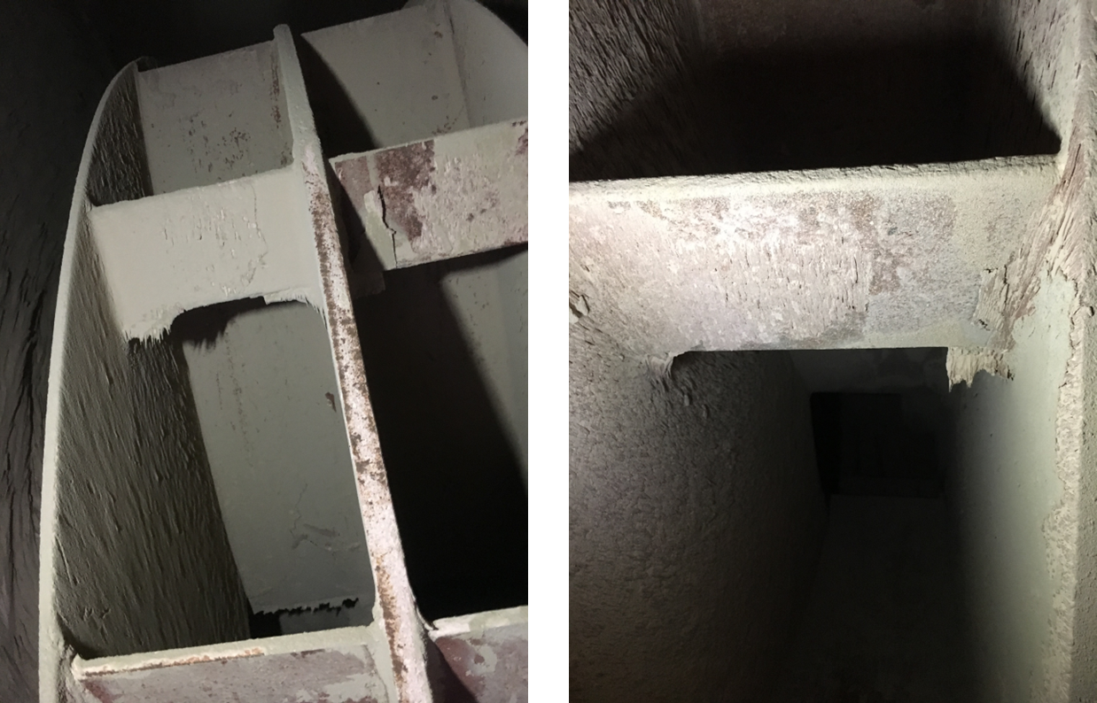
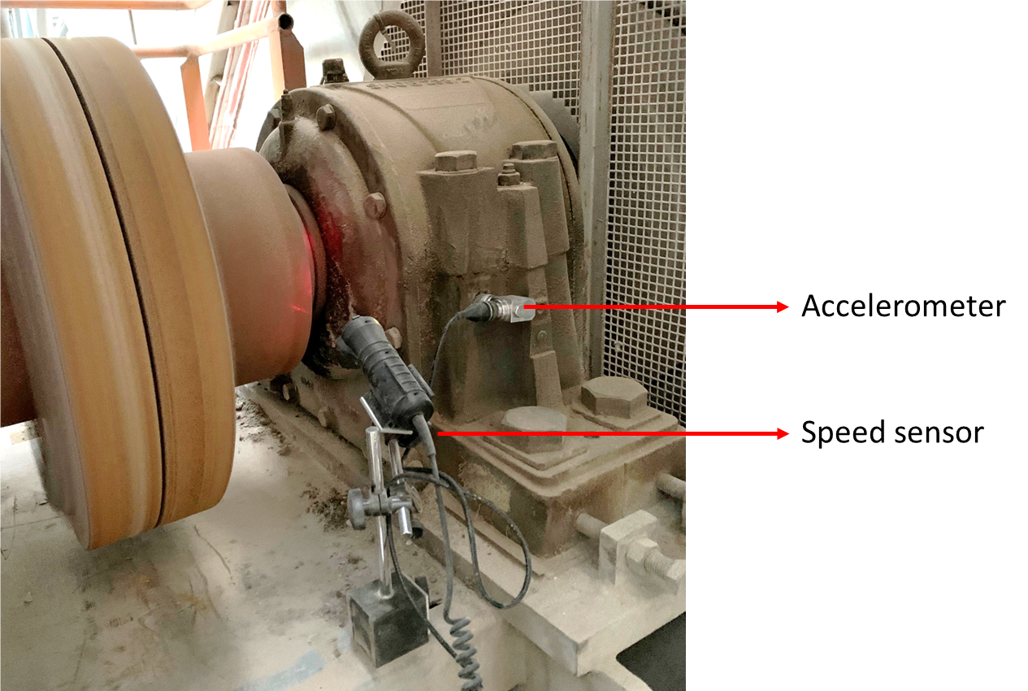
Case Study I
Corrective Actions:
Impeller Cleaning
Impeller Balancing (G2.5, ISO 1940-1) – Added weight: 2.97kg at FAN DE and 2.5kg at FAN NDE

Slide 11
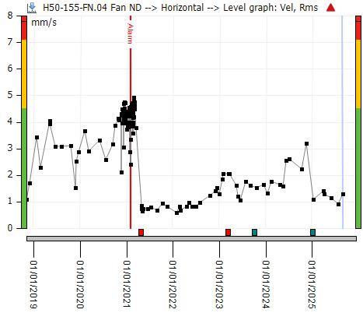
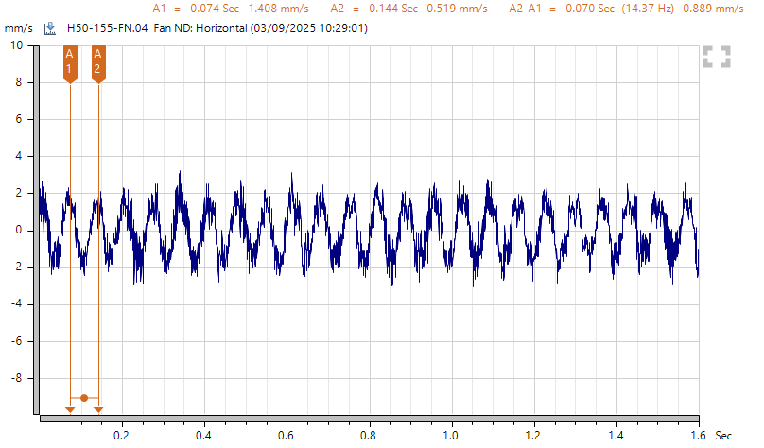
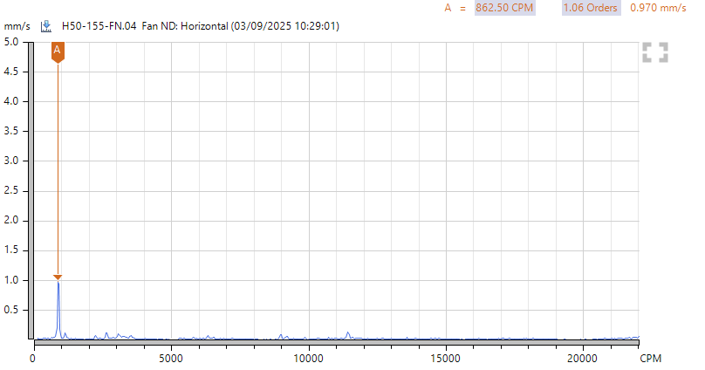
Case Study I
1x RPM
863
FFT

Slide 12
Case Study II
Asset ID: J52-235FN
Asset Description:
Cement Mill 6 Exhauster Fan
Criticality in Production:
High (Operation time: continuous during Cement Mill 6 Operation)
Measuring equipment:
Leonova Diamond SPM
Triaxial Accelerometer, SPM
Measurement Points:
Motor NDE, Motor DE
Fan DE Bearing, Fan NDE bearing
Measurement Periodicity: Monthly
Speed: 800 – 900 RPM

Slide 13
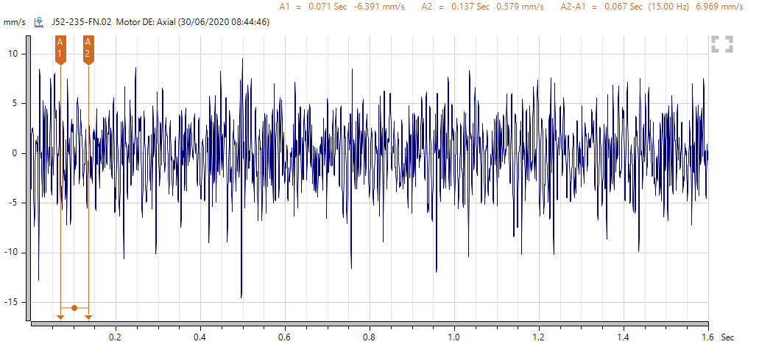
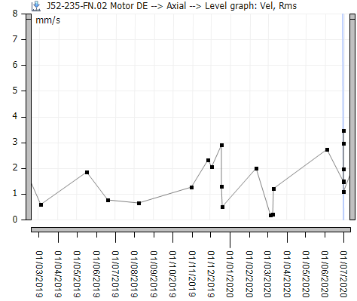
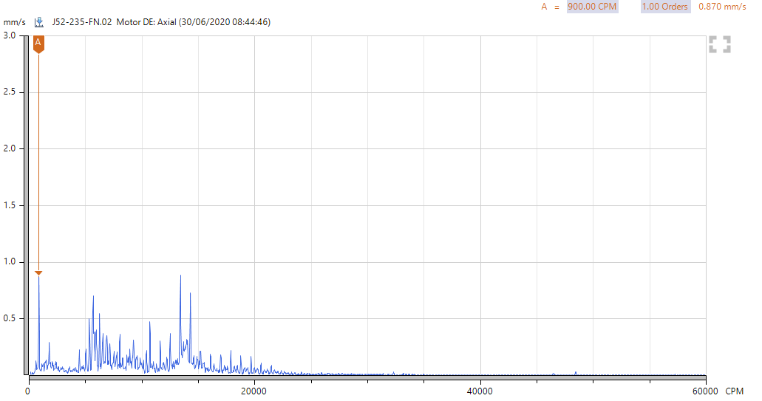
Case Study II
FFT
Observations:
Motor & Fan vibration (Vrms) increased at axial direction
Energy is spread over multiple harmonics – indicating coupling wear and/or misalignment
1x RPM
900

Slide 14
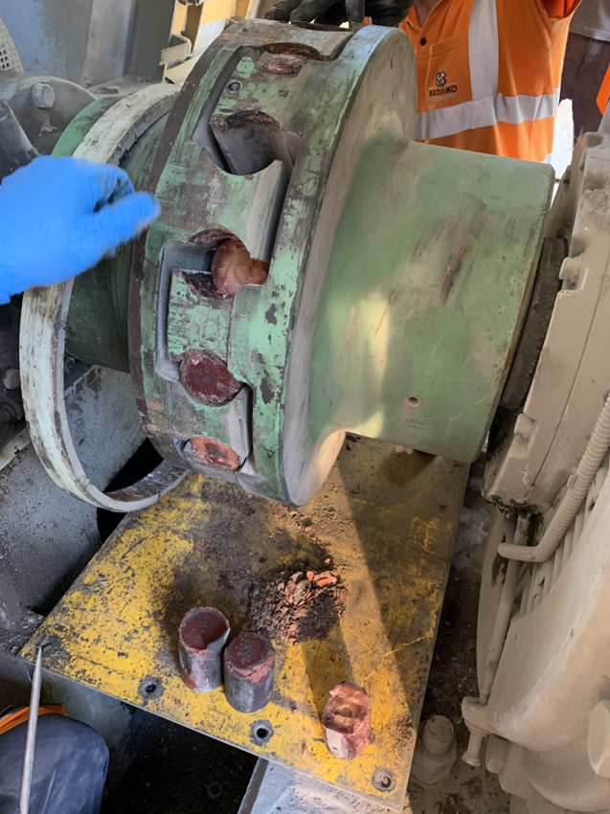
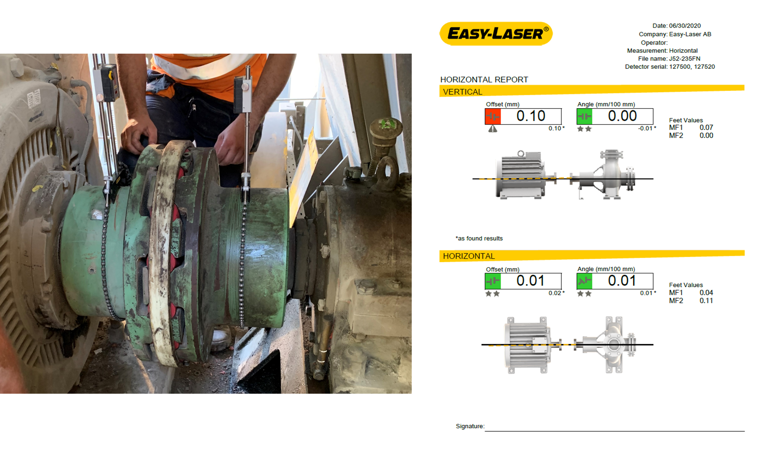
Case Study II
Corrective Actions:
Elastic buffers replacement
Shaft alignment inspection using laser equipment – found ok

Slide 15
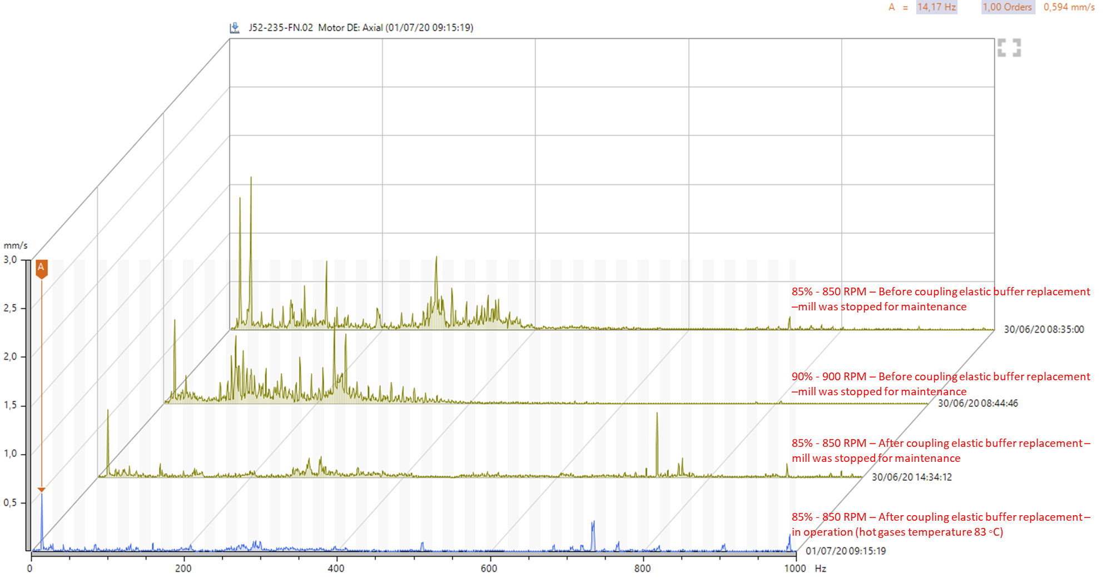
Case Study II

Slide 16
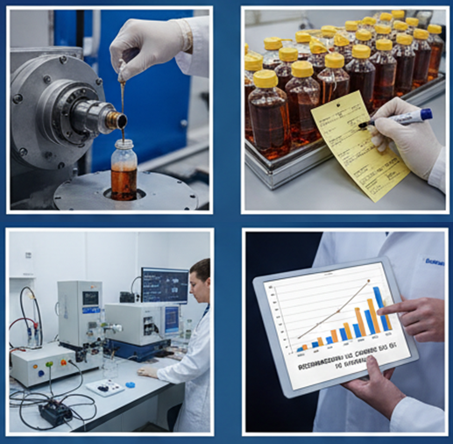
Lubricant Analysis
Objective:
Identify early signs of component wear
Detect contaminants (water, dirt, metals)
Monitor oil condition and additive health
Optimize maintenance and oil change intervals
Key Indicators:
Viscosity change = contamination or aging
Water = corrosion risk
Metal content = wear from components
Sludge or darkening = oxidation or overheating
Sampling & Handling:
Sample from active oil zones
Avoid contamination during sampling
Label and store samples correctly
Maintain regular sampling intervals
Interpreting Results:
Compare with baseline and OEM limits
Focus on trends over time, not single results
Use results to guide maintenance decision

Slide 17
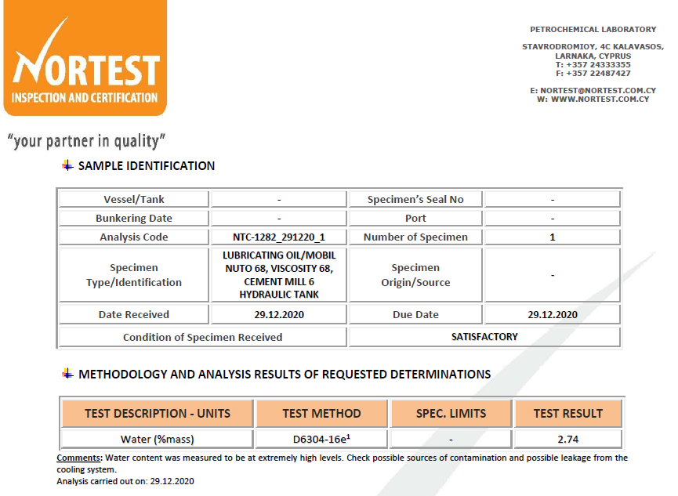
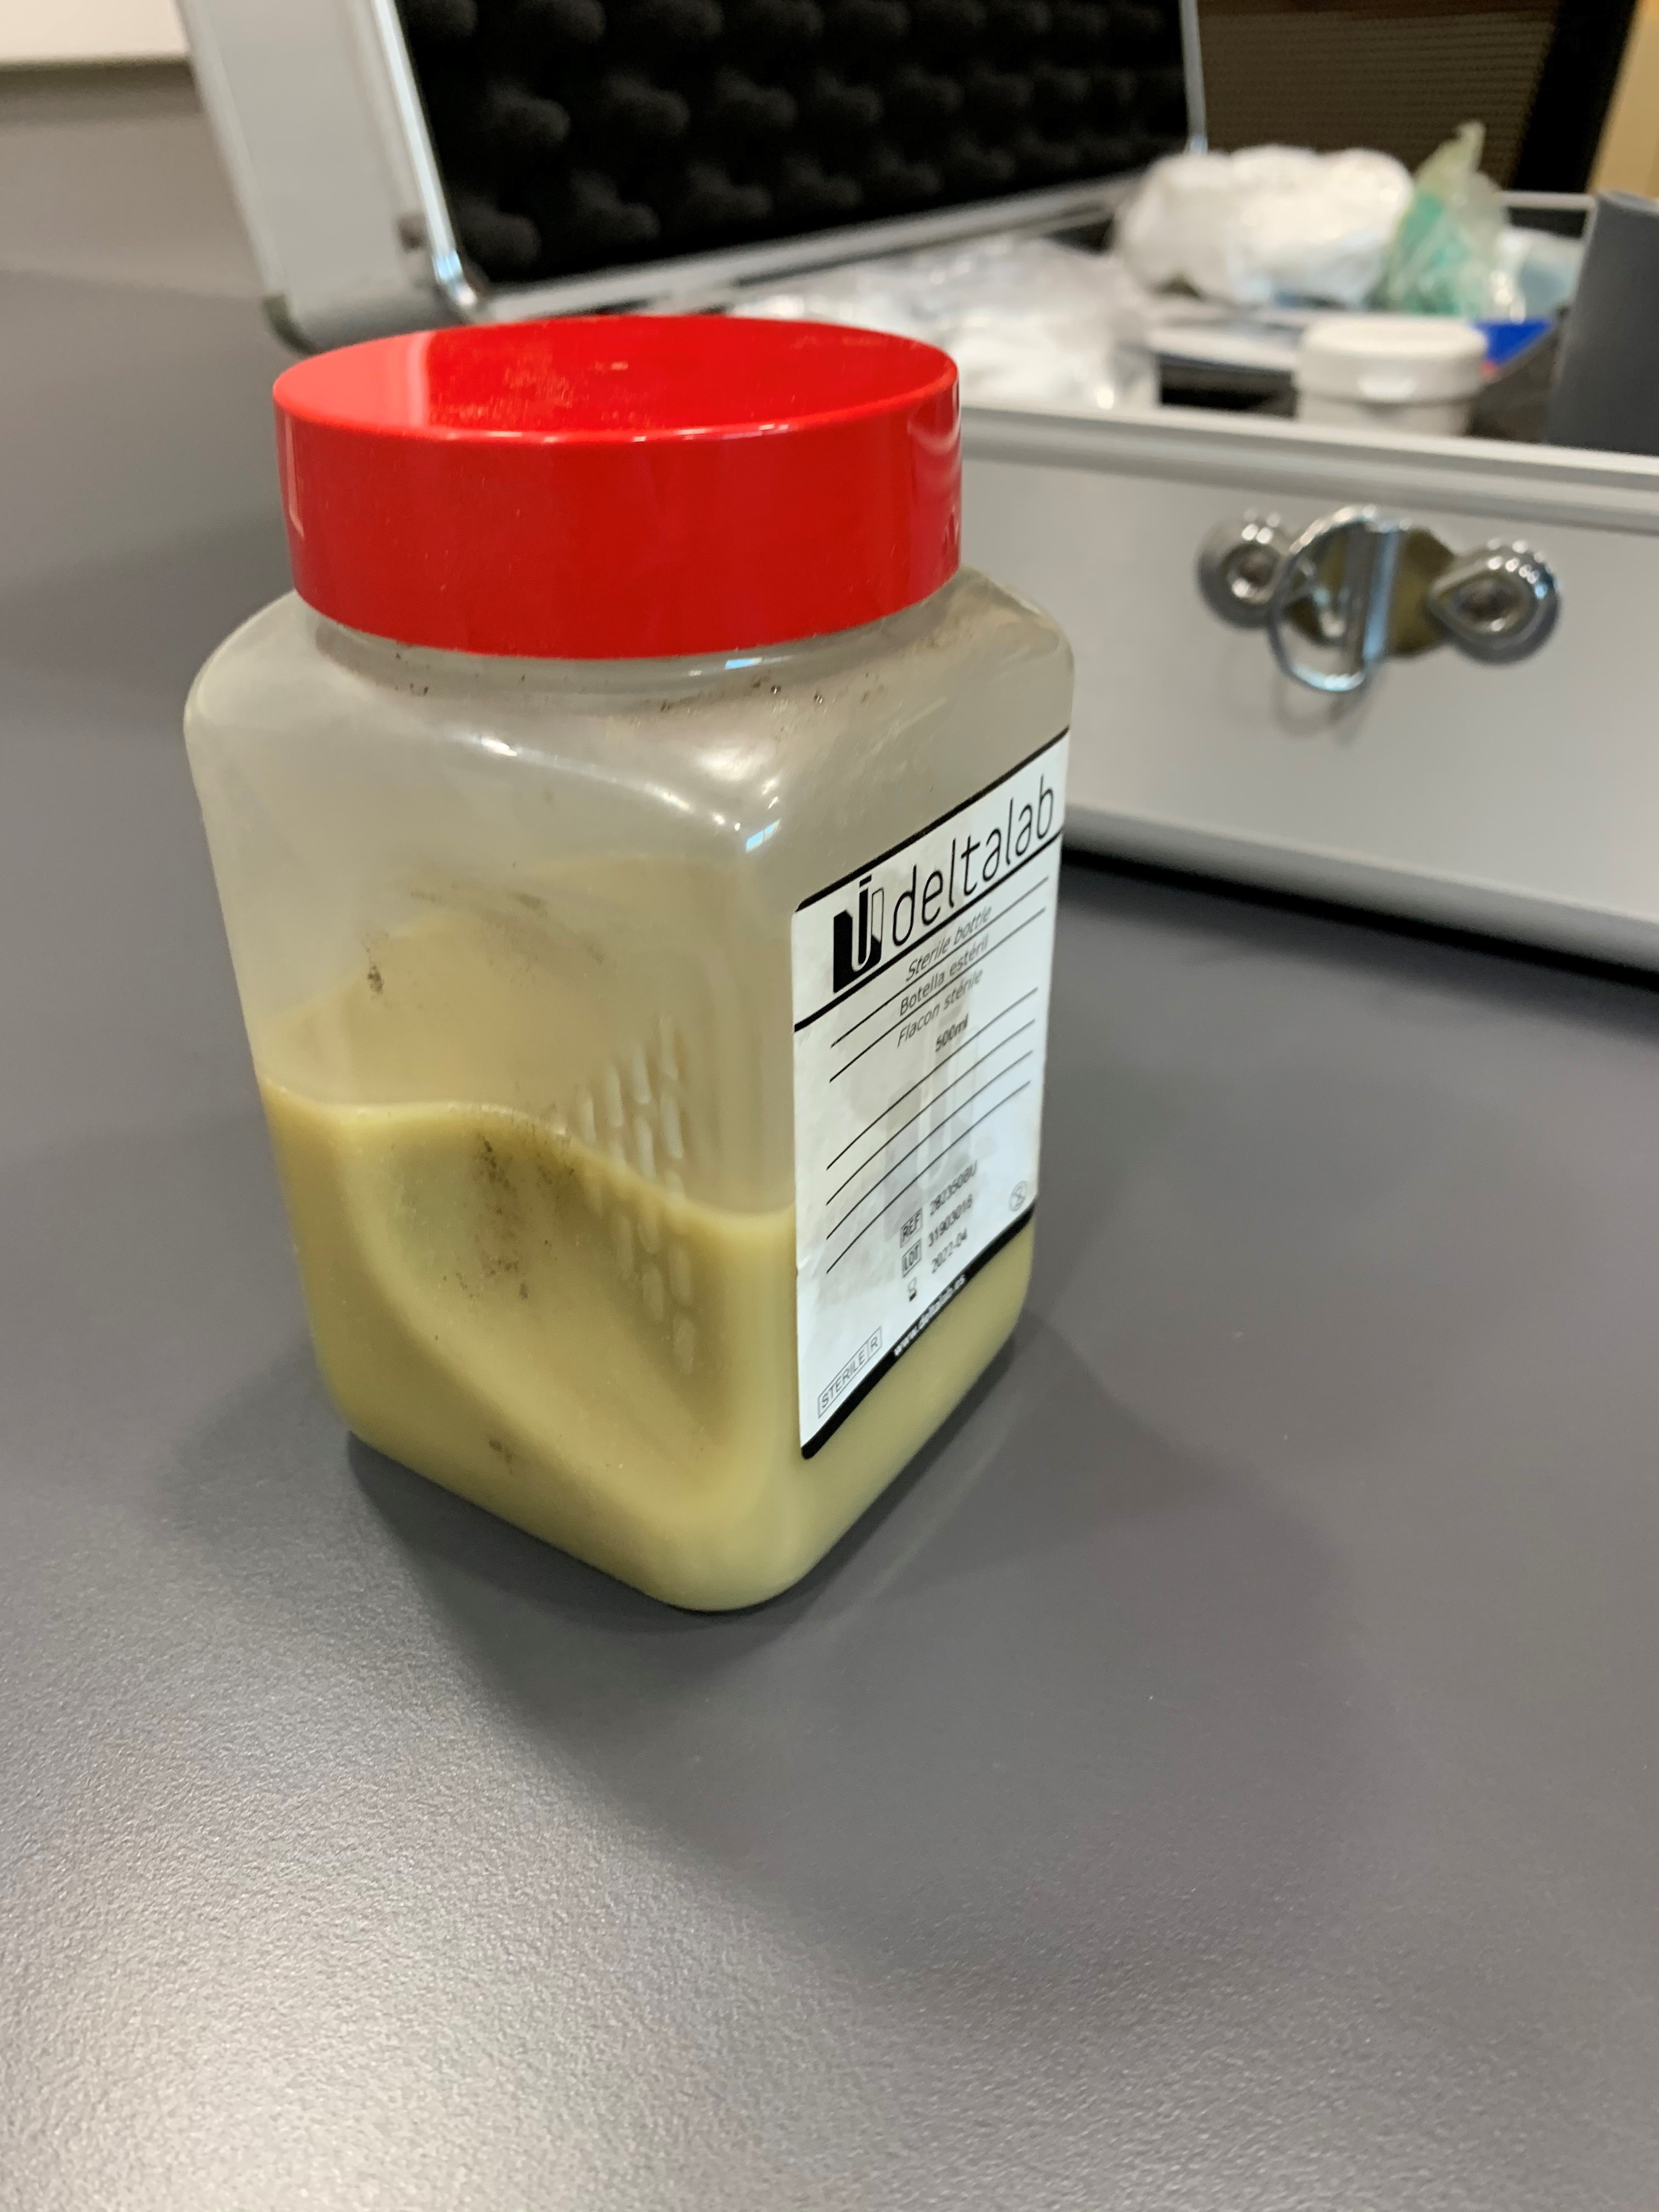
Case Study III
Observations:
Oil sample – Visual inspection – milky appearance
Analysis results: Increased water content (2.74%)
Water limit: 0.03%

Slide 18
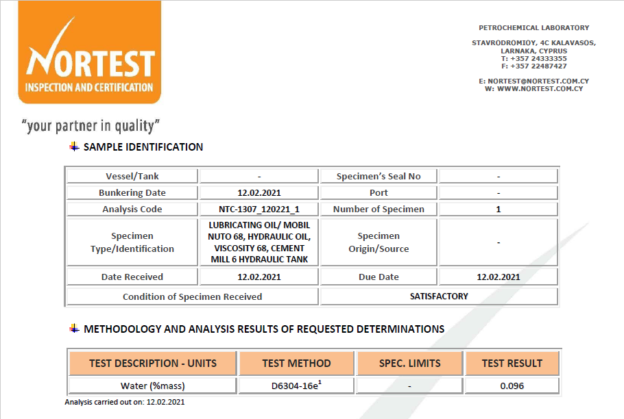
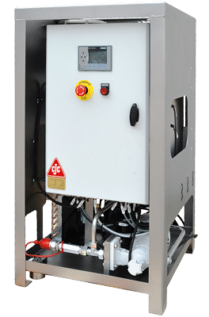
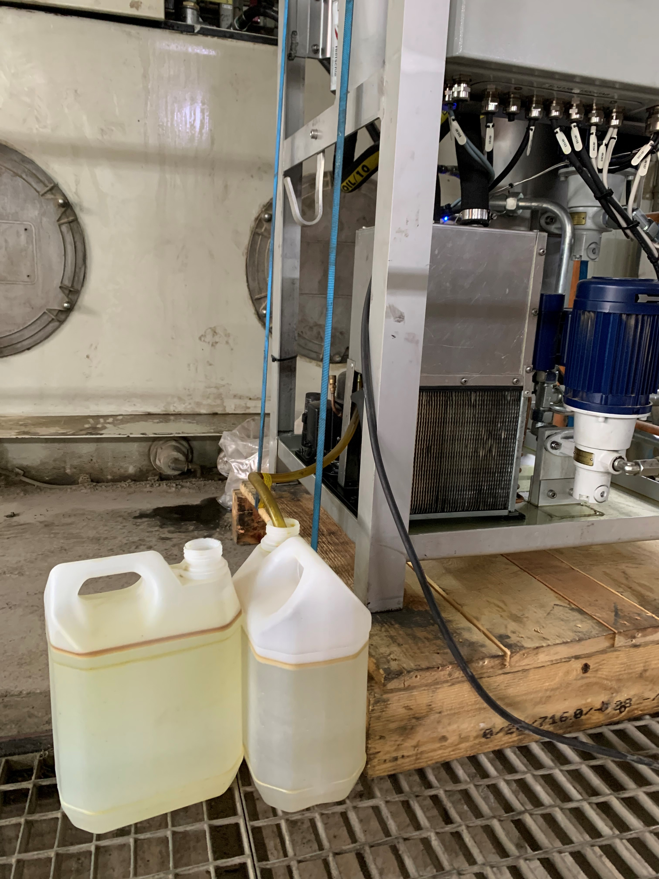

Case Study III
Corrective Actions:
Filtration – removed dissolved and emulsified water

Slide 19
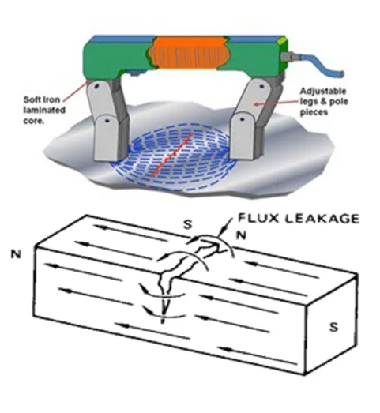
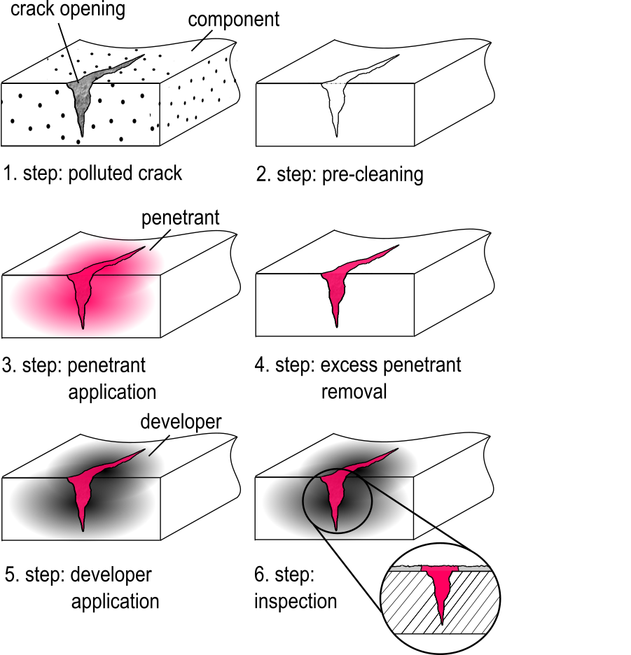
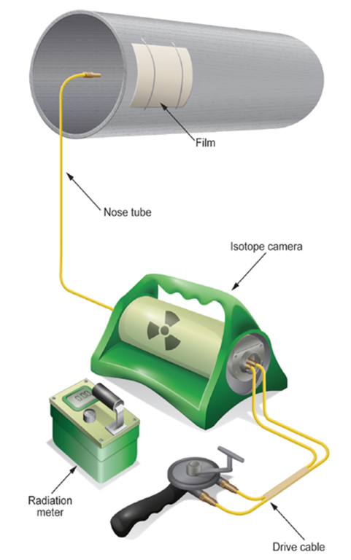
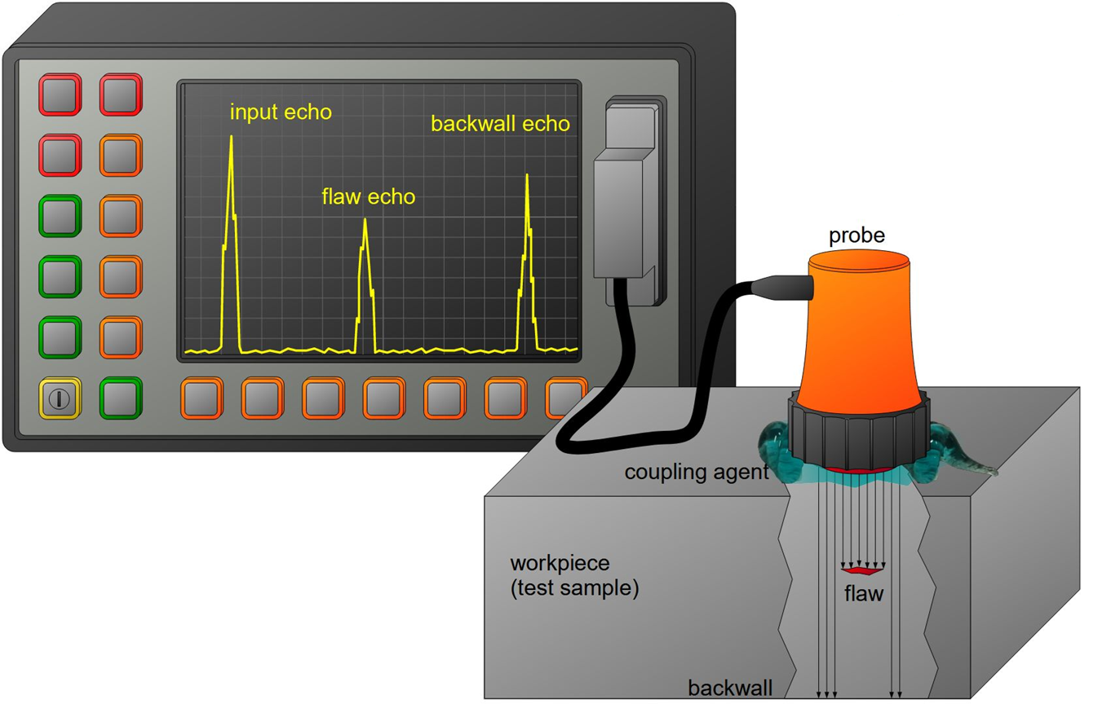
Non-Destructive Testing (NDT)
Objective:
Identify internal or surface flaws early, without damaging components
Prevent catastrophic failures
Support maintenance planning
Extend asset service life
Common NDT Methods:
Ultrasonic Testing (UT)
Magnetic Particle Testing (MT)
Dye Penetrant Testing (PT)
Radiographic Testing (RT)
Uses high-frequency sound waves
Detects internal flaws and material thickness
For ferromagnetic materials
Reveals surface and near-surface cracks
Highlights surface-breaking defects
Used on non-porous materials
X-rays or gamma rays reveal internal defects
Suitable for welds and castings

Slide 20
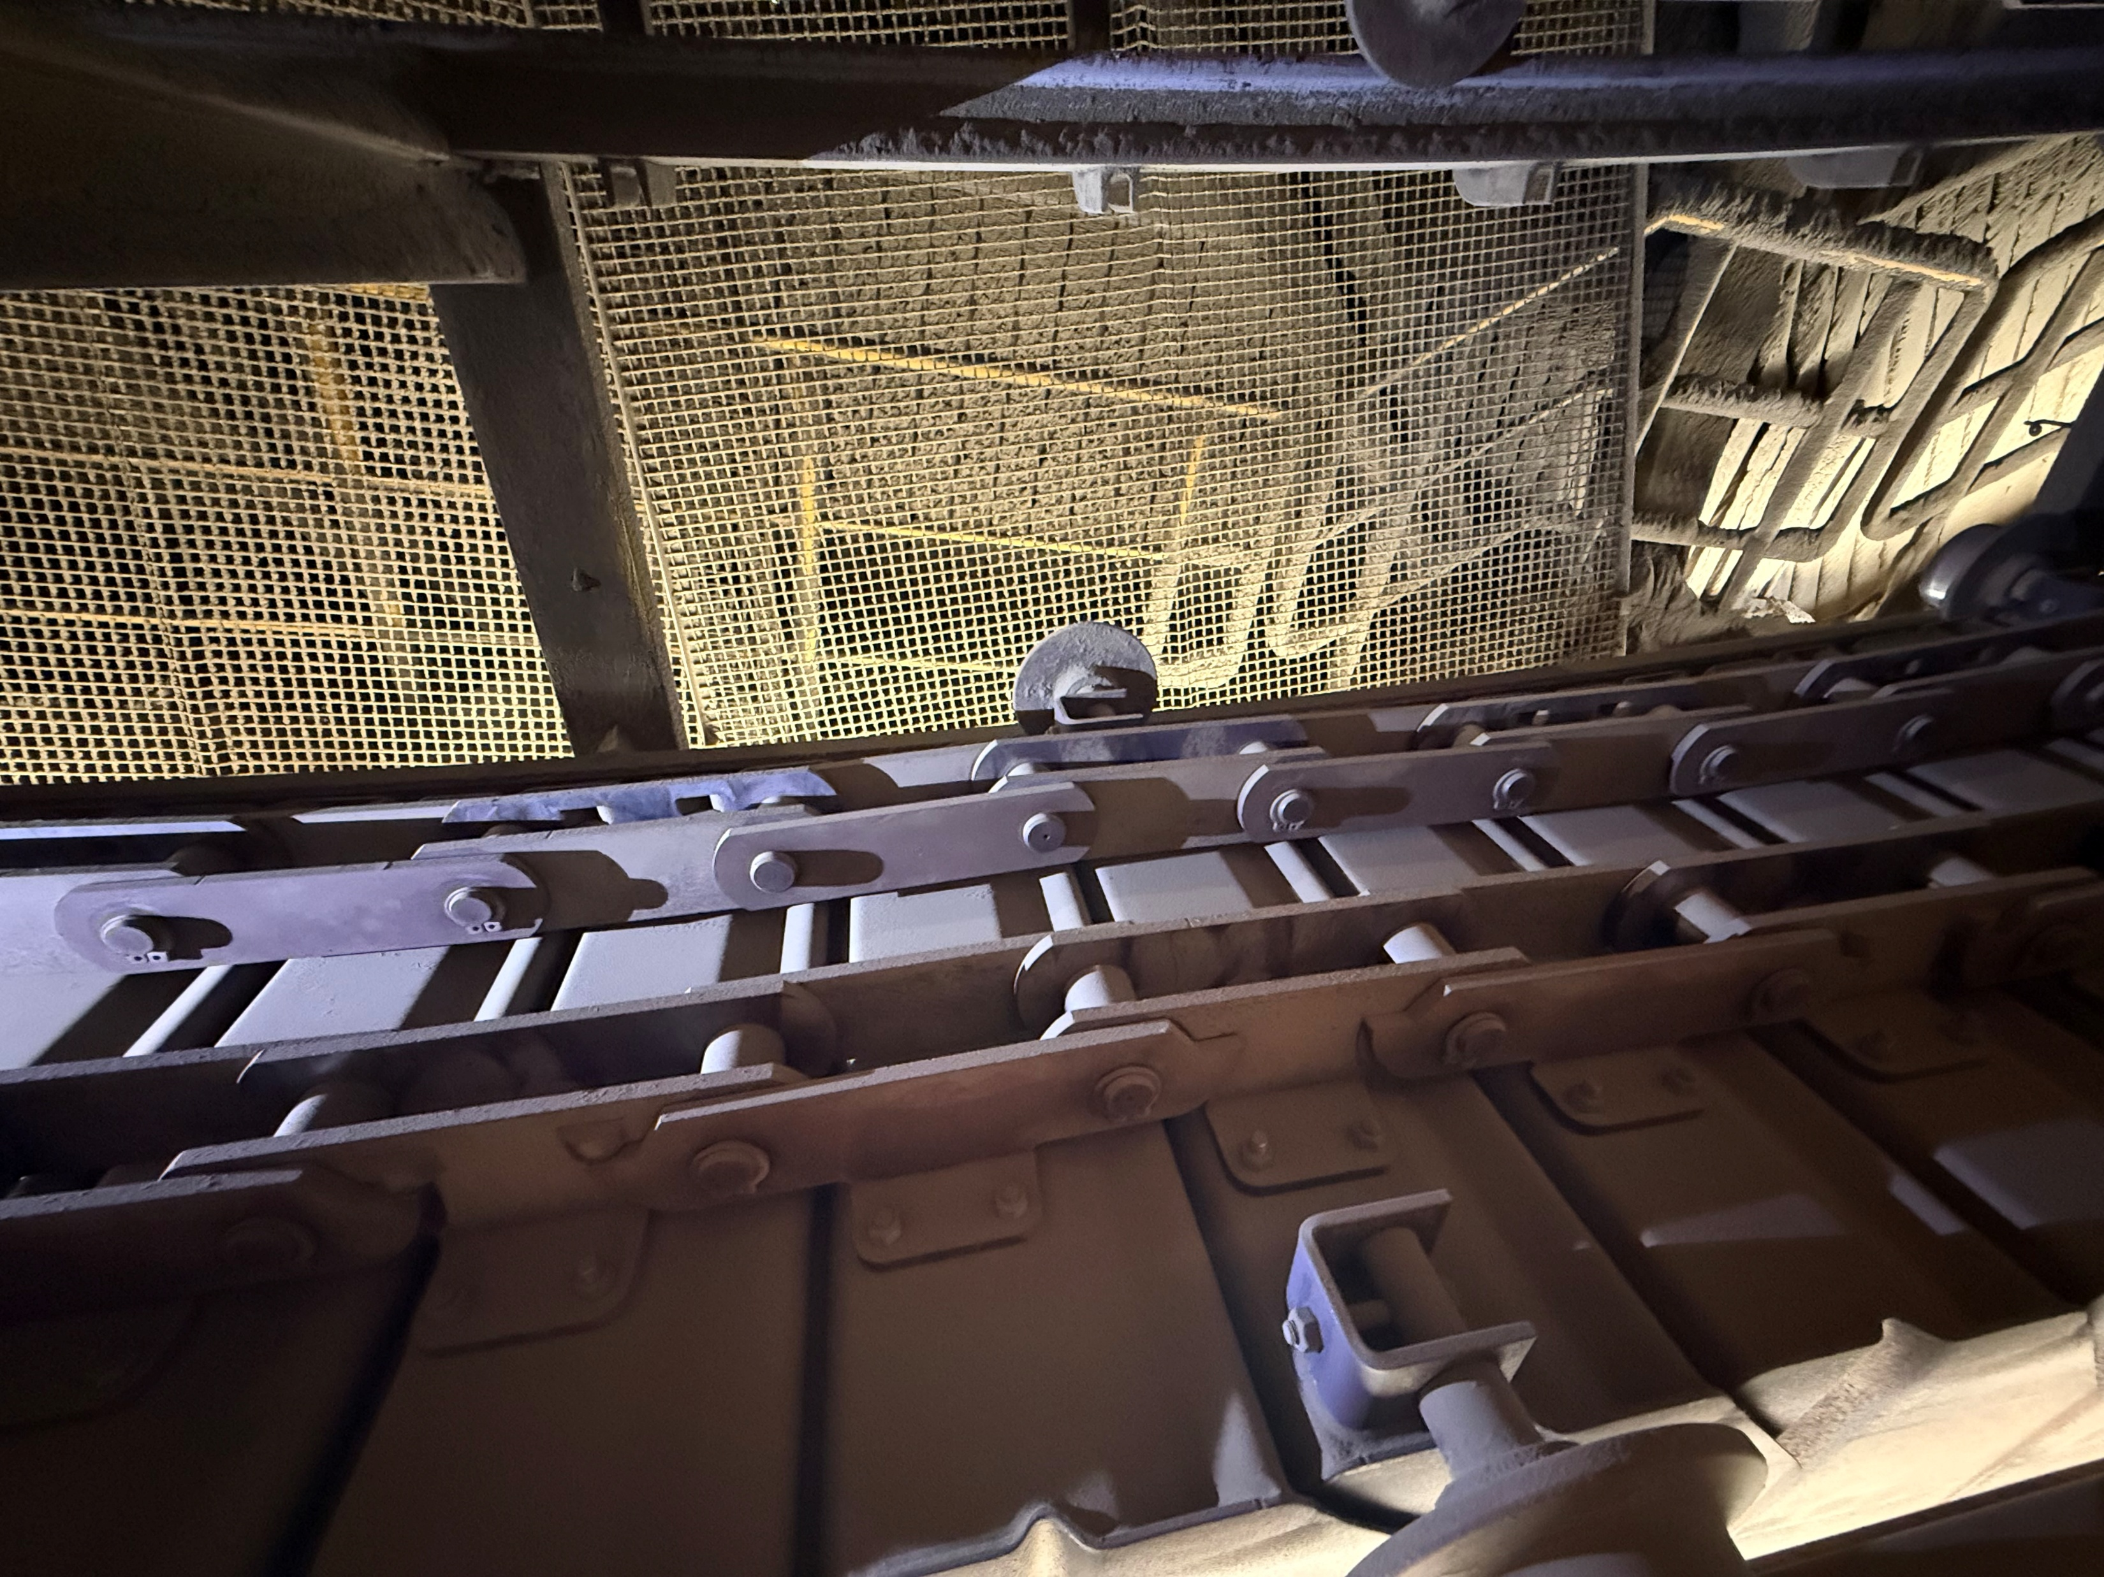
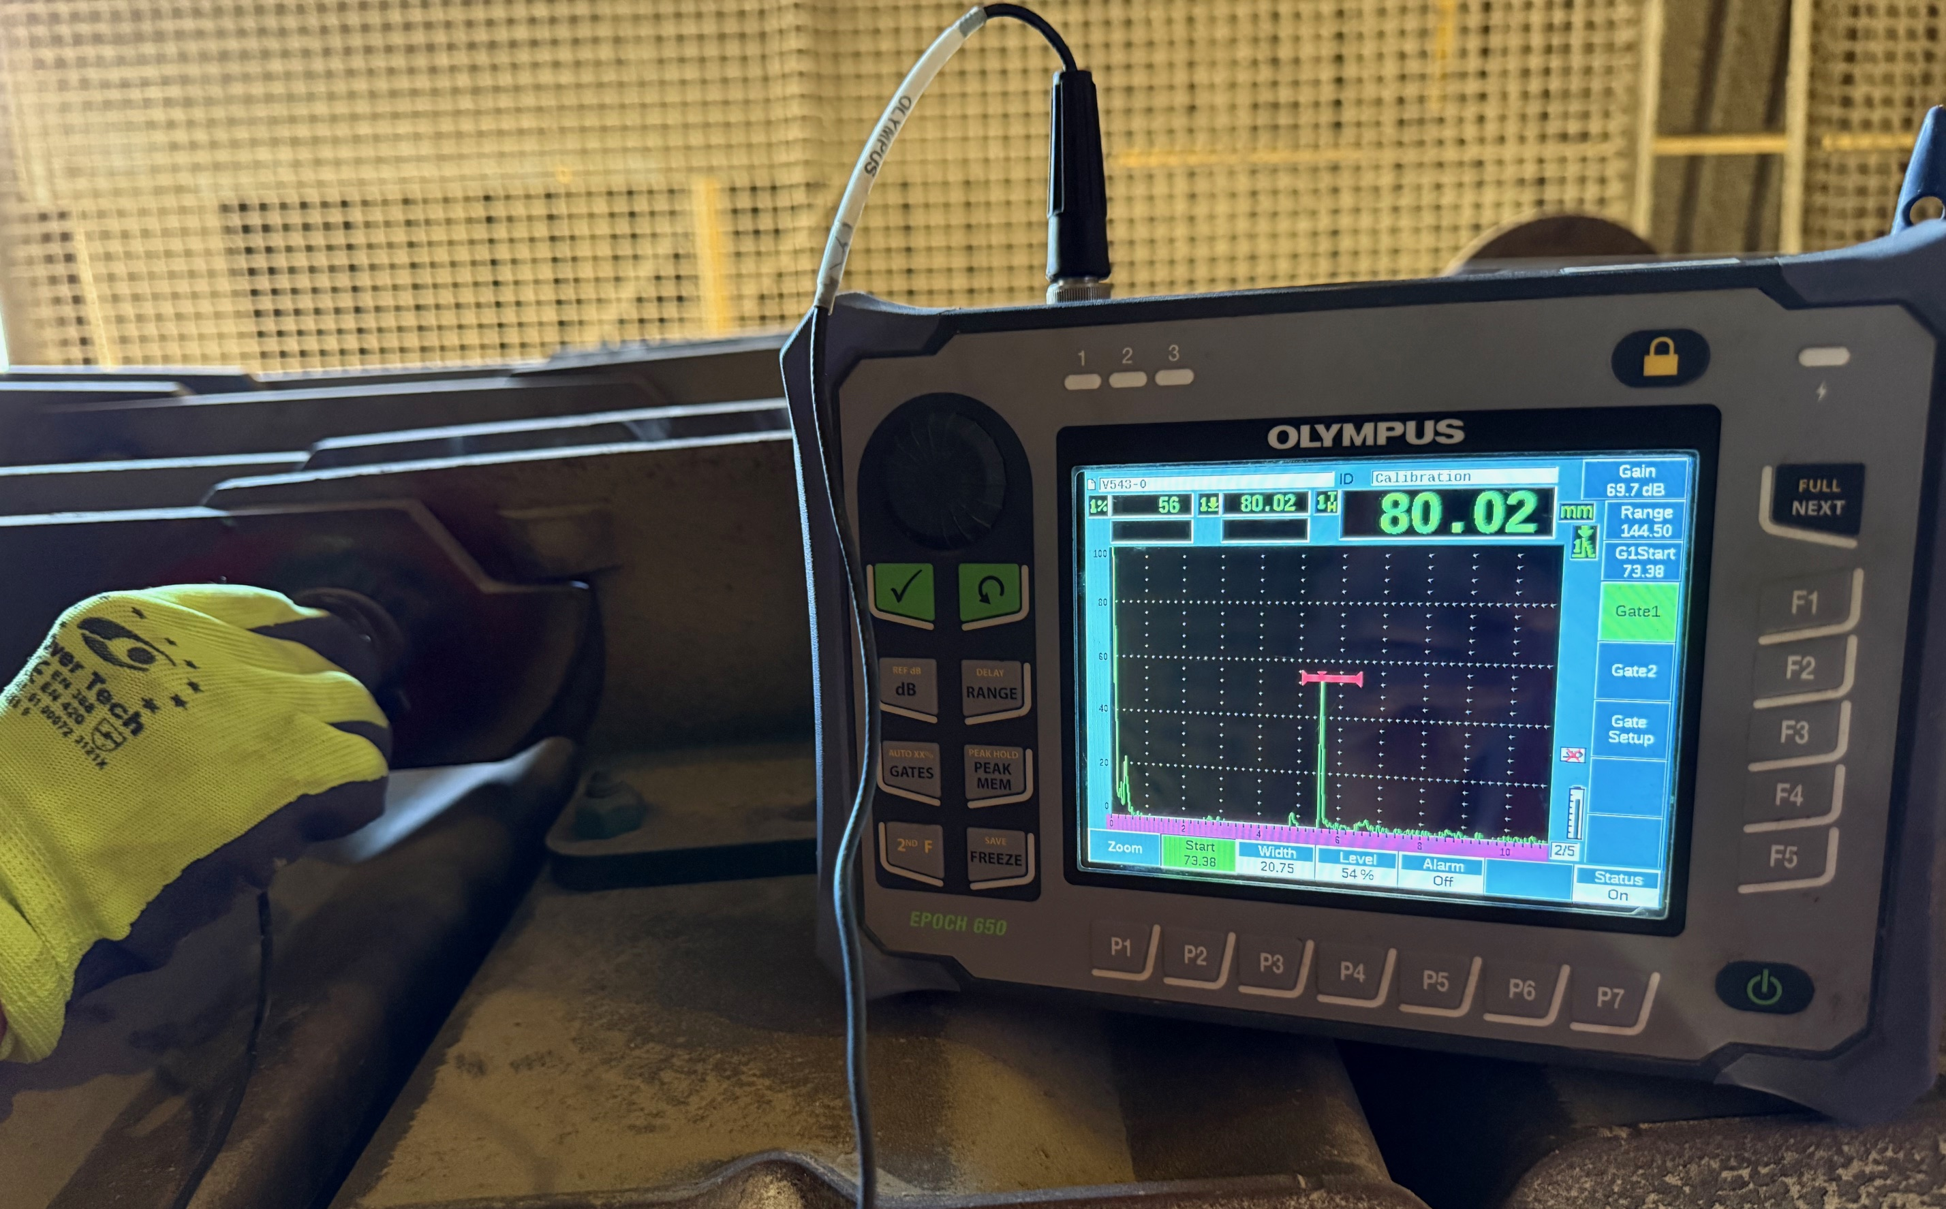
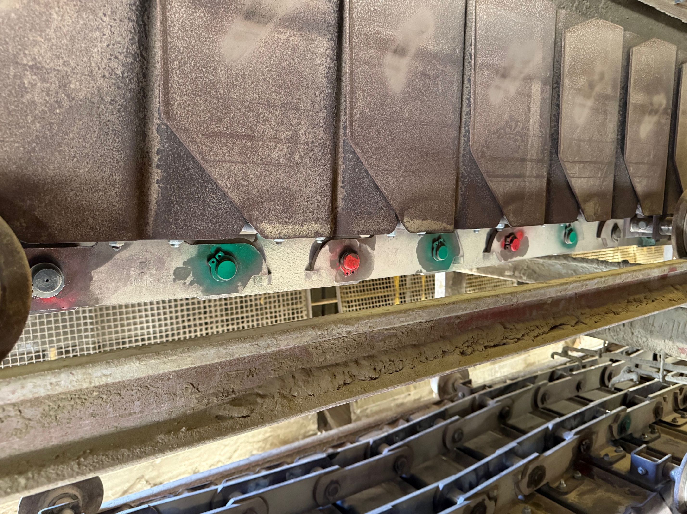
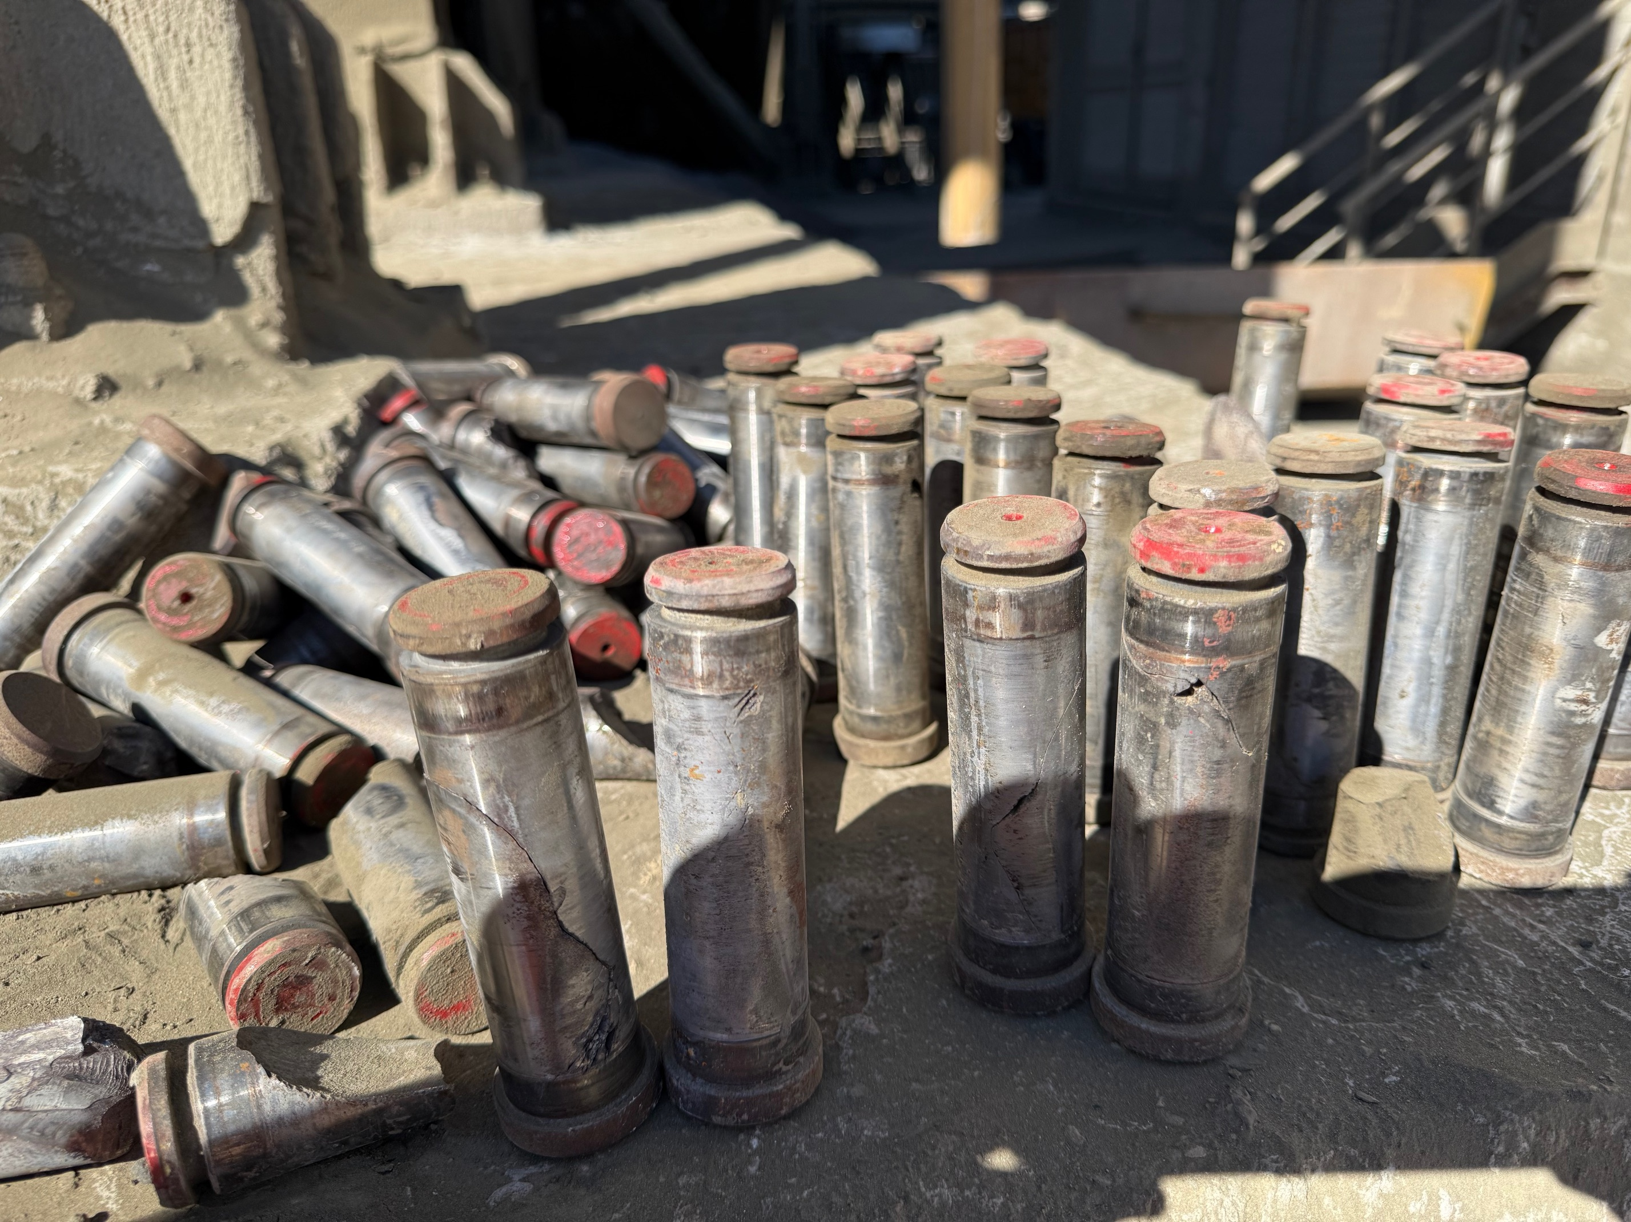
Case Study IV
Asset ID: I30-160PC
Asset Description:
Pan Conveyor to Clinker Silo II
Measuring equipment:
Olympus EPOCH 650 flaw detector
Measurement Points:
Chain Pins
Objective:
Inspect pins for cracks
Observations & Corrective Actions:
Considerable number of pins were cracked – Must investigate the Root Cause
Cracked pins replaced to avoid a possible crash or pan conveyor derailment

Slide 21
PdM: Enabling Quality Through Foresight
Prevents Defects Before They Happen
By detecting equipment wear or anomalies early, PdM reduces process variation and prevents defective products caused by out-of-spec machinery
Ensures Process Consistency & Stability
Continuous monitoring maintains machines within optimal operating conditions, ensuring consistent output quality and repeatable performance.
Reduces Unplanned Downtime & Rework
Reliable equipment minimizes production interruptions, scrap, and rework — key drivers of poor quality and waste.
Supports Continuous Improvement & Compliance
PdM data enables root-cause analysis, supports ISO 9001 principles (risk-based thinking, evidence-based decisions), and drives ongoing quality enhancement.
“Quality is achieved not by reacting to problems, but by anticipating them”

